Slide 1
Data Mining
Practical Machine Learning Tools and Techniques
Slides for Chapter 4, Algorithms: the basic methods
of Data Mining by I. H. Witten, E. Frank, M. A. Hall and C. J. Pal

Slide 2
Algorithms: The basic methods
Inferring rudimentary rules
Simple probabilistic modeling
Constructing decision trees
Constructing rules
Association rule learning
Linear models
Instance-based learning
Clustering
Multi-instance learning

Slide 3
Simplicity first
Simple algorithms often work very well!
There are many kinds of simple structure, e.g.:
One attribute does all the work
All attributes contribute equally & independently
Logical structure with a few attributes suitable for tree
A set of simple logical rules
Relationships between groups of attributes
A weighted linear combination of the attributes
Strong neighborhood relationships based on distance
Clusters of data in unlabeled data
Bags of instances that can be aggregated
Success of method depends on the domain

Slide 4
Inferring rudimentary rules
1R rule learner: learns a 1-level decision tree
A set of rules that all test one particular attribute that has been identified as the one that yields the lowest classification error
Basic version for finding the rule set from a given training set (assumes nominal attributes):
For each attribute
Make one branch for each value of the attribute
To each branch, assign the most frequent class value of the instances pertaining to that branch
Error rate: proportion of instances that do not belong to the majority class of their corresponding branch
Choose attribute with lowest error rate

Slide 5
Pseudo-code for 1R
For each attribute,
For each value of the attribute, make a rule as follows:
count how often each class appears
find the most frequent class
make the rule assign that class to this attribute-value
Calculate the error rate of the rules
Choose the rules with the smallest error rate
1R’s handling of missing values: a missing value is treated as a separate attribute value

Slide 6
Evaluating the weather attributes
Outlook
Temp
Humidity
Windy
Play
Sunny
Hot
High
False
No
Attribute
Rules
Errors
Total errors
Sunny
Hot
High
True
No
Outlook
Sunny → No
2/5
4/14
Overcast
Hot
High
False
Yes
Overcast → Yes
0/4
Rainy
Mild
High
False
Yes
Rainy → Yes
2/5
Rainy
Cool
Normal
False
Yes
Temp
Hot → No*
2/4
5/14
Rainy
Cool
Normal
True
No
Mild → Yes
2/6
Overcast
Cool
Normal
True
Yes
Cool → Yes
1/4
Sunny
Mild
High
False
No
Humidity
High → No
3/7
4/14
Sunny
Cool
Normal
False
Yes
Normal → Yes
1/7
Rainy
Mild
Normal
False
Yes
Windy
False → Yes
2/8
5/14
Sunny
Mild
Normal
True
Yes
True → No*
3/6
Overcast
Mild
High
True
Yes
Overcast
Hot
Normal
False
Yes
Rainy
Mild
High
True
No
* indicates a tie

Slide 7
Dealing with numeric attributes
Idea: discretize numeric attributes into sub ranges (intervals)
How to divide each attribute’s overall range into intervals?
Sort instances according to attribute’s values
Place breakpoints where (majority) class changes
This minimizes the total classification error
Example: temperature from weather data
64 65 68 69 70 71 72 72 75 75 80 81 83 85
Yes | No | Yes Yes Yes | No No Yes | Yes Yes | No | Yes Yes | No
Outlook
Temperature
Humidity
Windy
Play
Sunny
85
85
False
No
Sunny
80
90
True
No
Overcast
83
86
False
Yes
Rainy
75
80
False
Yes
…
…
…
…
…

Slide 8
The problem of overfitting
Discretization procedure is very sensitive to noise
A single instance with an incorrect class label will probably produce a separate interval
Also, something like a time stamp attribute will have zero errors
Simple solution: enforce minimum number of instances in majority class per interval
Example: temperature attribute with required minimum number of instances in majority class set to three:
64 65 68 69 70 71 72 72 75 75 80 81 83 85
Yes | No | Yes Yes Yes | No No Yes | Yes Yes | No | Yes Yes | No
64 65 68 69 70 71 72 72 75 75 80 81 83 85
Yes No Yes Yes Yes | No No Yes Yes Yes | No Yes Yes No

Slide 9
Results with overfitting avoidance
Resulting rule sets for the four attributes in the weather data, with only two rules for the temperature attribute:
Attribute
Rules
Errors
Total errors
Outlook
Sunny → No
2/5
4/14
Overcast → Yes
0/4
Rainy → Yes
2/5
Temperature
≤ 77.5 → Yes
3/10
5/14
> 77.5 → No*
2/4
Humidity
≤ 82.5 → Yes
1/7
3/14
> 82.5 and ≤ 95.5 → No
2/6
> 95.5 → Yes
0/1
Windy
False → Yes
2/8
5/14
True → No*
3/6

Slide 10
Discussion of 1R
1R was described in a paper by Holte (1993):
Contains an experimental evaluation on 16 datasets (using cross-validation to estimate classification accuracy on fresh data)
Required minimum number of instances in majority class was set to 6 after some experimentation
1R’s simple rules performed not much worse than much more complex decision trees
Lesson: simplicity first can pay off on practical datasets
Note that 1R does not perform as well on more recent, more sophisticated benchmark datasets
Very Simple Classification Rules Perform Well on Most Commonly Used Datasets
Robert C. Holte, Computer Science Department, University of Ottawa

Slide 11
Simple probabilistic modeling
“Opposite” of 1R: use all the attributes
Two assumptions: Attributes are
equally important
statistically independent (given the class value)
This means knowing the value of one attribute tells us nothing about the value of another takes on (if the class is known)
Independence assumption is almost never correct!
But … this scheme often works surprisingly well in practice
The scheme is easy to implement in a program and very fast
It is known as naïve Bayes

Slide 12
Probabilities for weather data
Outlook
Temperature
Humidity
Windy
Play
Yes
No
Yes
No
Yes
No
Yes
No
Yes
No
Sunny
2
3
Hot
2
2
High
3
4
False
6
2
9
5
Overcast
4
0
Mild
4
2
Normal
6
1
True
3
3
Rainy
3
2
Cool
3
1
Sunny
2/9
3/5
Hot
2/9
2/5
High
3/9
4/5
False
6/9
2/5
9/
14
5/
14
Overcast
4/9
0/5
Mild
4/9
2/5
Normal
6/9
1/5
True
3/9
3/5
Rainy
3/9
2/5
Cool
3/9
1/5
Outlook
Temp
Humidity
Windy
Play
Sunny
Hot
High
False
No
Sunny
Hot
High
True
No
Overcast
Hot
High
False
Yes
Rainy
Mild
High
False
Yes
Rainy
Cool
Normal
False
Yes
Rainy
Cool
Normal
True
No
Overcast
Cool
Normal
True
Yes
Sunny
Mild
High
False
No
Sunny
Cool
Normal
False
Yes
Rainy
Mild
Normal
False
Yes
Sunny
Mild
Normal
True
Yes
Overcast
Mild
High
True
Yes
Overcast
Hot
Normal
False
Yes
Rainy
Mild
High
True
No

Slide 13
Probabilities for weather data
Outlook
Temperature
Humidity
Windy
Play
Yes
No
Yes
No
Yes
No
Yes
No
Yes
No
Sunny
2
3
Hot
2
2
High
3
4
False
6
2
9
5
Overcast
4
0
Mild
4
2
Normal
6
1
True
3
3
Rainy
3
2
Cool
3
1
Sunny
2/9
3/5
Hot
2/9
2/5
High
3/9
4/5
False
6/9
2/5
9/
14
5/
14
Overcast
4/9
0/5
Mild
4/9
2/5
Normal
6/9
1/5
True
3/9
3/5
Rainy
3/9
2/5
Cool
3/9
1/5
A new day:
Outlook
Temp.
Humidity
Windy
Play
Sunny
Cool
High
True
?
Likelihood of the two classes
For “yes” = 2/9 × 3/9 × 3/9 × 3/9 × 9/14 = 0.0053
For “no” = 3/5 × 1/5 × 4/5 × 3/5 × 5/14 = 0.0206
Conversion into a probability by normalization:
P(“yes”) = 0.0053 / (0.0053 + 0.0206) = 0.205
P(“no”) = 0.0206 / (0.0053 + 0.0206) = 0.795

Slide 14
Can combine probabilities using Bayes’s rule
Famous rule from probability theory due to
Probability of an event H given observed evidence E:
A priori probability of H :
Probability of event before evidence is seen
A posteriori probability of H :
Probability of event after evidence is seen
Thomas Bayes
Born: 1702 in London, England Died: 1761 in Tunbridge Wells, Kent, England

Slide 15
Naïve Bayes for classification
Classification learning: what is the probability of the class given an instance?
Evidence E = instance’s non-class attribute values
Event H = class value of instance
Naïve assumption: evidence splits into parts (i.e., attributes) that are conditionally independent
This means, given n attributes, we can write Bayes’ rule using a product of per-attribute probabilities:

Slide 16
Weather data example
Outlook
Temp.
Humidity
Windy
Play
Evidence E
Sunny
Cool
High
True
?
Probability of
class “yes”

Slide 17
The “zero-frequency problem”
What if an attribute value does not occur with every class value? (e.g., “Humidity = high” for class “yes”)
Probability will be zero:
A posteriori probability will also be zero: (Regardless of how likely the other values are!)
Remedy: add 1 to the count for every attribute value-class combination (Laplace estimator)
Result: probabilities will never be zero
Additional advantage: stabilizes probability estimates computed from small samples of data

Slide 18
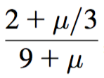
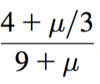
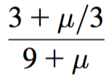
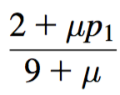
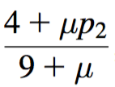
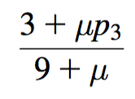
Modified probability estimates
In some cases adding a constant different from 1 might be more appropriate
Example: attribute outlook for class yes
Weights don’t need to be equal (but they must sum to 1)
Sunny
Overcast
Rainy

Slide 19
Missing values
Training: instance is not included in frequency count for attribute value-class combination
Classification: attribute will be omitted from calculation
Example:
Outlook
Temp.
Humidity
Windy
Play
?
Cool
High
True
?
Likelihood of “yes” = 3/9 × 3/9 × 3/9 × 9/14 = 0.0238
Likelihood of “no” = 1/5 × 4/5 × 3/5 × 5/14 = 0.0343
P(“yes”) = 0.0238 / (0.0238 + 0.0343) = 41%
P(“no”) = 0.0343 / (0.0238 + 0.0343) = 59%

Slide 20
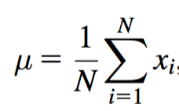
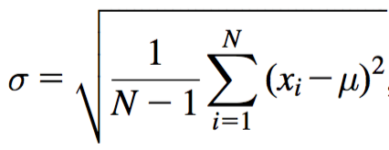
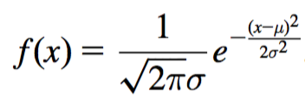
Numeric attributes
Usual assumption: attributes have a normal or Gaussian probability distribution (given the class)
The probability density function for the normal distribution is defined by two parameters:
Sample mean μ
Standard deviation σ
Then the density function f(x) is

Slide 21
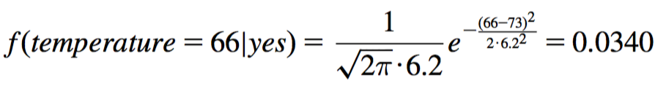
Statistics for weather data
Outlook
Temperature
Humidity
Windy
Play
Yes
No
Yes
No
Yes
No
Yes
No
Yes
No
Sunny
2
3
64, 68,
65,71,
65, 70,
70, 85,
False
6
2
9
5
Overcast
4
0
69, 70,
72,80,
70, 75,
90, 91,
True
3
3
Rainy
3
2
72, …
85, …
80, …
95, …
Sunny
2/9
3/5
μ =73
μ =75
μ =79
μ =86
False
6/9
2/5
9/
14
5/
14
Overcast
4/9
0/5
σ =6.2
σ =7.9
σ =10.2
σ =9.7
True
3/9
3/5
Rainy
3/9
2/5
Example density value:

Slide 22
Classifying a new day
A new day:
Missing values during training are not included in calculation of mean and standard deviation
Outlook
Temp.
Humidity
Windy
Play
Sunny
66
90
true
?
Likelihood of “yes” = 2/9 × 0.0340 × 0.0221 × 3/9 × 9/14 = 0.000036
Likelihood of “no” = 3/5 × 0.0221 × 0.0381 × 3/5 × 5/14 = 0.000108
P(“yes”) = 0.000036 / (0.000036 + 0. 000108) = 25%
P(“no”) = 0.000108 / (0.000036 + 0. 000108) = 75%

Slide 23
Probability densities
Probability densities f(x) can be greater than 1; hence, they are not probabilities
However, they must integrate to 1: the area under the probability density curve must be 1
Approximate relationship between probability and probability density can be stated as assuming ε is sufficiently small
When computing likelihoods, we can treat densities just like probabilities

Slide 24
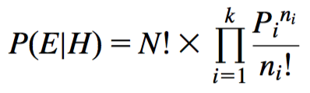
Multinomial naïve Bayes I
Version of naïve Bayes used for document classification using bag of words model
n₁,n₂, ... , n_{k}: number of times word i occurs in the document
P₁,P₂, ... , P_{k}: probability of obtaining word i when sampling from documents in class H
Probability of observing a particular document E given probabilities class H (based on multinomial distribution):
Note that this expression ignores the probability of generating a document of the right length
This probability is assumed to be constant for all classes

Slide 25
Multinomial naïve Bayes II
Suppose dictionary has two words, yellow and blue
Suppose P(yellow | H) = 75% and P(blue | H) = 25%
Suppose E is the document “blue yellow blue”
Probability of observing document: Suppose there is another class H' that has P(yellow | H’) = 10% and P(blue| H’) = 90%:
Need to take prior probability of class into account to make the final classification using Bayes’ rule
Factorials do not actually need to be computed: they drop out
Underflows can be prevented by using logarithms
‘

Slide 26
Naïve Bayes: discussion
Naïve Bayes works surprisingly well even if independence assumption is clearly violated
Why? Because classification does not require accurate probability estimates as long as maximum probability is assigned to the correct class
However: adding too many redundant attributes will cause problems (e.g., identical attributes)
Note also: many numeric attributes are not normally distributed (kernel density estimators can be used instead)

Slide 27
Constructing decision trees
Strategy: top down learning using recursive divide-and-conquer process
First: select attribute for root node Create branch for each possible attribute value
Then: split instances into subsets One for each branch extending from the node
Finally: repeat recursively for each branch, using only instances that reach the branch
Stop if all instances have the same class

Slide 28
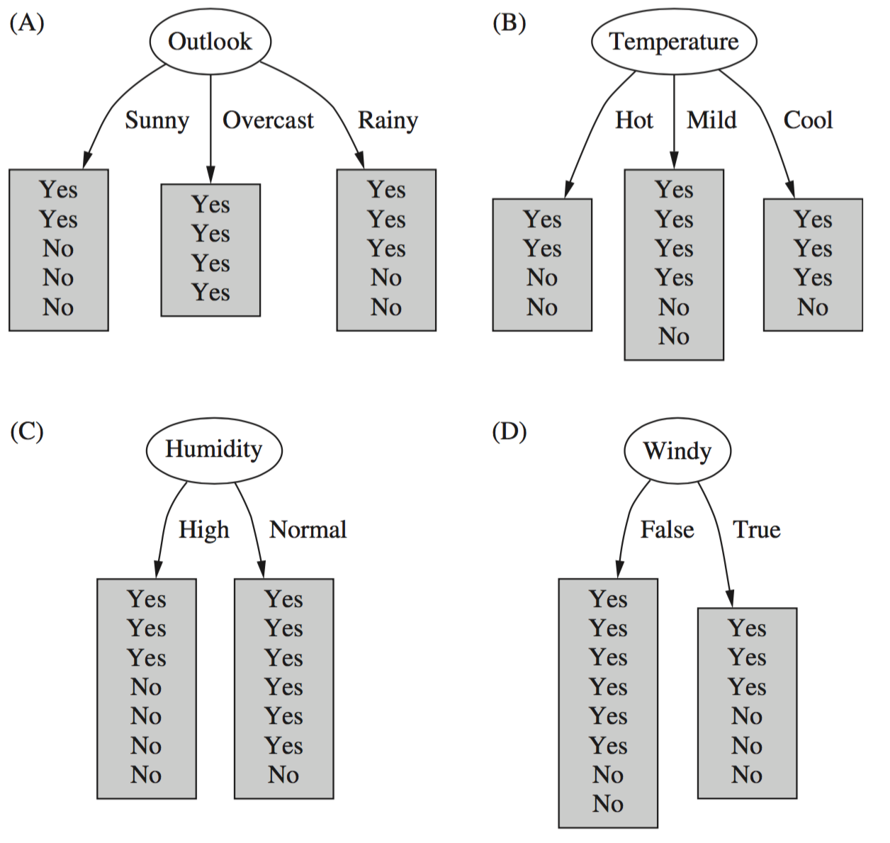
Which attribute to select?

Slide 29
Which attribute to select?

Slide 30
Criterion for attribute selection
Which is the best attribute?
Want to get the smallest tree
Heuristic: choose the attribute that produces the “purest” nodes
Popular selection criterion: information gain
Information gain increases with the average purity of the subsets
Strategy: amongst attributes available for splitting, choose attribute that gives greatest information gain
Information gain requires measure of impurity
Impurity measure that it uses is the entropy of the class distribution, which is a measure from information theory

Slide 31
Computing information
We have a probability distribution: the class distribution in a subset of instances
The expected information required to determine an outcome (i.e., class value), is the distribution’s entropy
Formula for computing the entropy:
Using base-2 logarithms, entropy gives the information required in expected bits
Entropy is maximal when all classes are equally likely and minimal when one of the classes has probability 1

Slide 32
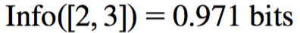
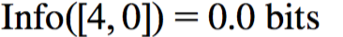
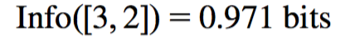
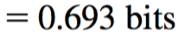
Example: attribute Outlook
Outlook = Sunny :
Outlook = Overcast :
Outlook = Rainy :
Expected information for attribute:

Slide 33
Computing information gain
Information gain: information before splitting – information after splitting
Information gain for attributes from weather data:
Gain(Outlook ) = Info([9,5]) – info([2,3],[4,0],[3,2])
= 0.940 – 0.693 = 0.247 bits
Gain(Outlook ) = 0.247 bits
Gain(Temperature ) = 0.029 bits
Gain(Humidity ) = 0.152 bits
Gain(Windy ) = 0.048 bits

Slide 34
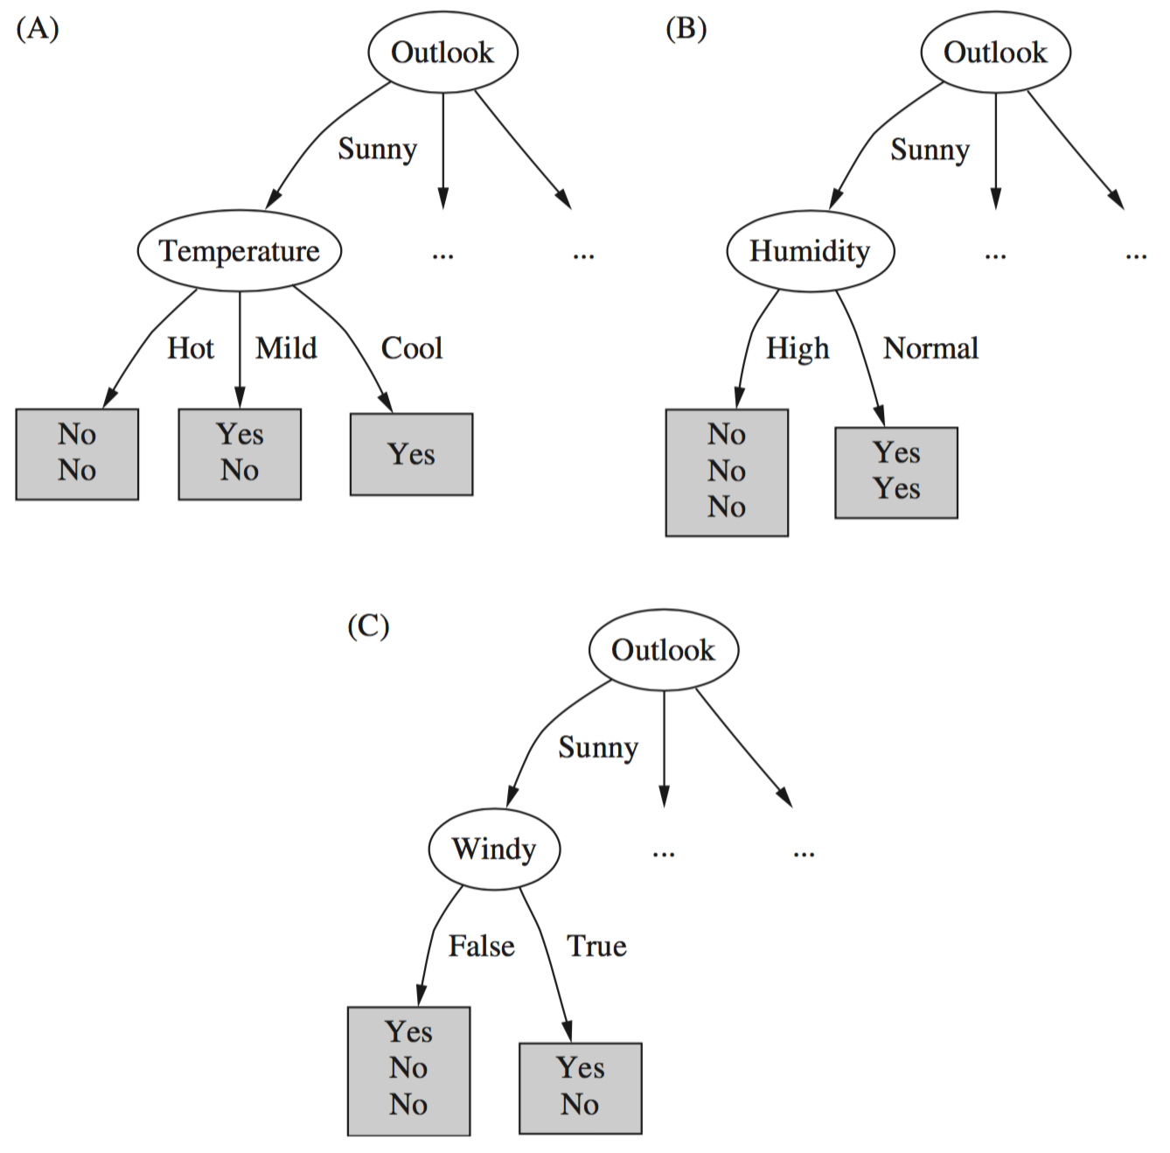
Continuing to split
Gain(Temperature ) = 0.571 bits
Gain(Humidity ) = 0.971 bits
Gain(Windy ) = 0.020 bits

Slide 35
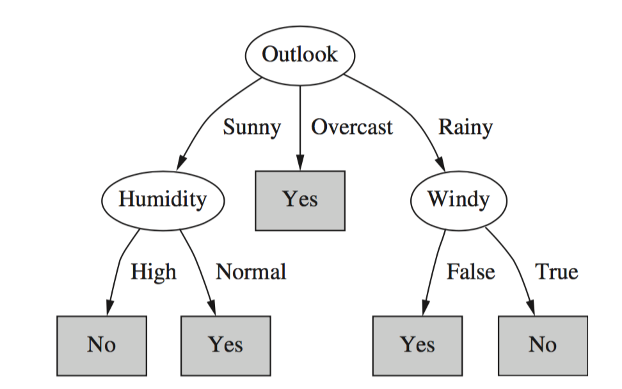
Final decision tree
Note: not all leaves need to be pure; sometimes identical instances have different classes
⇒ Splitting stops when data cannot be split any further

Slide 36
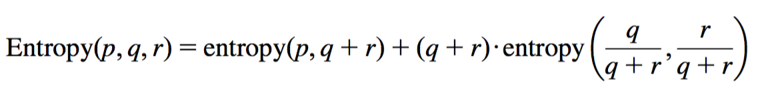
Wishlist for an impurity measure
Properties we would like to see in an impurity measure:
When node is pure, measure should be zero
When impurity is maximal (i.e., all classes equally likely), measure should be maximal
Measure should ideally obey multistage property (i.e., decisions can be made in several stages):
It can be shown that entropy is the only function that satisfies all three properties!
Note that the multistage property is intellectually pleasing but not strictly necessary in practice

Slide 37
Highly-branching attributes
Problematic: attributes with a large number of values (extreme case: ID code)
Subsets are more likely to be pure if there is a large number of values
Information gain is biased towards choosing attributes with a large number of values
This may result in overfitting (selection of an attribute that is non-optimal for prediction)
An additional problem in decision trees is data fragmentation

Slide 38
Weather data with ID code
ID code
Outlook
Temp.
Humidity
Windy
Play
A
Sunny
Hot
High
False
No
B
Sunny
Hot
High
True
No
C
Overcast
Hot
High
False
Yes
D
Rainy
Mild
High
False
Yes
E
Rainy
Cool
Normal
False
Yes
F
Rainy
Cool
Normal
True
No
G
Overcast
Cool
Normal
True
Yes
H
Sunny
Mild
High
False
No
I
Sunny
Cool
Normal
False
Yes
J
Rainy
Mild
Normal
False
Yes
K
Sunny
Mild
Normal
True
Yes
L
Overcast
Mild
High
True
Yes
M
Overcast
Hot
Normal
False
Yes
N
Rainy
Mild
High
True
No

Slide 39
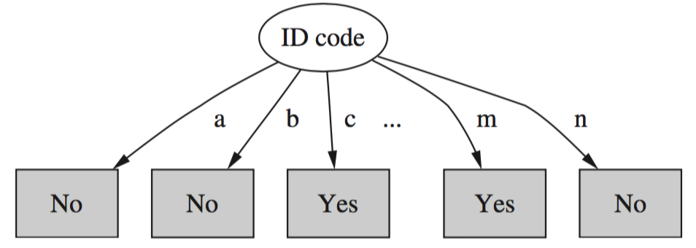
Tree stump for ID code attribute
All (single-instance) subsets have entropy zero!
This means the information gain is maximal for this ID code attribute (namely 0.940 bits)

Slide 40
Gain ratio
Gain ratio is a modification of the information gain that reduces its bias towards attributes with many values
Gain ratio takes number and size of branches into account when choosing an attribute
It corrects the information gain by taking the intrinsic information of a split into account
Intrinsic information: entropy of the distribution of instances into branches
Measures how much info do we need to tell which branch a randomly chosen instance belongs to

Slide 41
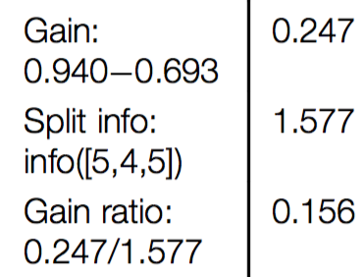
Computing the gain ratio
Example: intrinsic information of ID code
Value of attribute should decrease as intrinsic information gets larger
The gain ratio is defined as the information gain of the attribute divided by its intrinsic information
Example (outlook at root node):

Slide 42
All gain ratios for the weather data
Outlook
Temperature
Info:
0.693
Info:
0.911
Gain: 0.940-0.693
0.247
Gain: 0.940-0.911
0.029
Split info: info([5,4,5])
1.577
Split info: info([4,6,4])
1.557
Gain ratio: 0.247/1.577
0.157
Gain ratio: 0.029/1.557
0.019
Humidity
Windy
Info:
0.788
Info:
0.892
Gain: 0.940-0.788
0.152
Gain: 0.940-0.892
0.048
Split info: info([7,7])
1.000
Split info: info([8,6])
0.985
Gain ratio: 0.152/1
0.152
Gain ratio: 0.048/0.985
0.049

Slide 43
More on the gain ratio
“Outlook” still comes out top
However: “ID code” has greater gain ratio
Standard fix: ad hoc test to prevent splitting on that type of identifier attribute
Problem with gain ratio: it may overcompensate
May choose an attribute just because its intrinsic information is very low
Standard fix: only consider attributes with greater than average information gain
Both tricks are implemented in the well-known C4.5 decision tree learner

Slide 44
Discussion
Top-down induction of decision trees: ID3, algorithm developed by Ross Quinlan
Gain ratio just one modification of this basic algorithm
C4.5 tree learner deals with numeric attributes, missing values, noisy data
Similar approach: CART tree learner
Uses Gini index rather than entropy to measure impurity
There are many other attribute selection criteria! (But little difference in accuracy of result)

Slide 45
Covering algorithms
Can convert decision tree into a rule set
Straightforward, but rule set overly complex
More effective conversions are not trivial and may incur a lot of computation
Instead, we can generate rule set directly
One approach: for each class in turn, find rule set that covers all instances in it (excluding instances not in the class)
Called a covering approach:
At each stage of the algorithm, a rule is identified that “covers” some of the instances

Slide 46
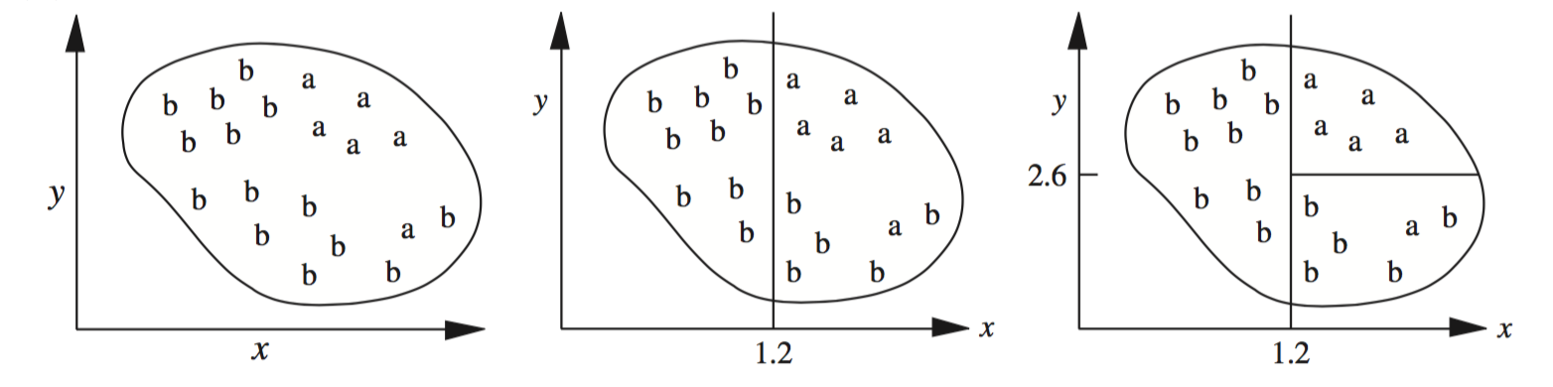
Example: generating a rule
If true then class = a
If x > 1.2 and y > 2.6 then class = a
If x > 1.2 then class = a
Possible rule set for class “b”:
Could add more rules, get “perfect” rule set
If x ≤ 1.2 then class = b
If x > 1.2 and y ≤ 2.6 then class = b

Slide 47
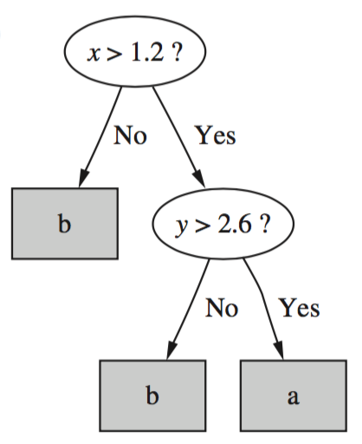
Rules vs. trees
Corresponding decision tree:
(produces exactly the same
predictions)
But: rule sets can be more perspicuous when decision trees suffer from replicated subtrees
Also: in multiclass situations, covering algorithm concentrates on one class at a time whereas decision tree learner takes all classes into account

Slide 48
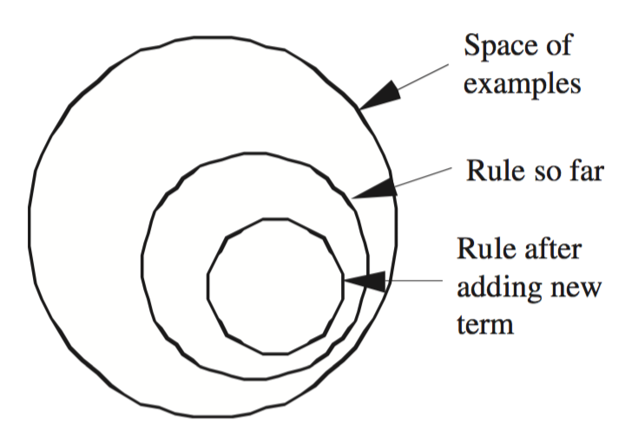
Simple covering algorithm
Basic idea: generate a rule by adding tests that maximize the rule’s accuracy
Similar to situation in decision trees: problem of selecting an attribute to split on
But: decision tree inducer maximizes overall purity
Each new test reduces rule’s coverage:

Slide 49
Selecting a test
Goal: maximize accuracy
t total number of instances covered by rule
p positive examples of the class covered by rule
t – p number of errors made by rule
Select test that maximizes the ratio p/t
We are finished when p/t = 1 or the set of instances cannot be split any further

Slide 50
Example: contact lens data
If ? then recommendation = hard
Rule we seek:
Possible tests:
Age = Young
2/8
Age = Pre-presbyopic
1/8
Age = Presbyopic
1/8
Spectacle prescription = Myope
3/12
Spectacle prescription = Hypermetrope
1/12
Astigmatism = no
0/12
Astigmatism = yes
4/12
Tear production rate = Reduced
0/12
Tear production rate = Normal
4/12

Slide 51
Modified rule and resulting data
Rule with best test added:
Instances covered by modified rule:
If astigmatism = yes then recommendation = hard
Age
Spectacle prescription
Astigmatism
Tear production rate
Recommended lenses
Young
Myope
Yes
Reduced
None
Young
Myope
Yes
Normal
Hard
Young
Hypermetrope
Yes
Reduced
None
Young
Hypermetrope
Yes
Normal
Hard
Pre-presbyopic
Myope
Yes
Reduced
None
Pre-presbyopic
Myope
Yes
Normal
Hard
Pre-presbyopic
Hypermetrope
Yes
Reduced
None
Pre-presbyopic
Hypermetrope
Yes
Normal
None
Presbyopic
Myope
Yes
Reduced
None
Presbyopic
Myope
Yes
Normal
Hard
Presbyopic
Hypermetrope
Yes
Reduced
None
Presbyopic
Hypermetrope
Yes
Normal
None

Slide 52
Further refinement
If astigmatism = yes and ? then recommendation = hard
Current state:
Possible tests:
Age = Young
2/4
Age = Pre-presbyopic
1/4
Age = Presbyopic
1/4
Spectacle prescription = Myope
3/6
Spectacle prescription = Hypermetrope
1/6
Tear production rate = Reduced
0/6
Tear production rate = Normal
4/6

Slide 53
Modified rule and resulting data
Rule with best test added:
Instances covered by modified rule:
If astigmatism = yes and tear production rate = normal then recommendation = hard
Age
Spectacle prescription
Astigmatism
Tear production rate
Recommended lenses
Young
Myope
Yes
Normal
Hard
Young
Hypermetrope
Yes
Normal
Hard
Pre-presbyopic
Myope
Yes
Normal
Hard
Pre-presbyopic
Hypermetrope
Yes
Normal
None
Presbyopic
Myope
Yes
Normal
Hard
Presbyopic
Hypermetrope
Yes
Normal
None

Slide 54
Further refinement
If astigmatism = yes and tear production rate = normal and ? then recommendation = hard
Current state:
Possible tests:
Tie between the first and the fourth test
We choose the one with greater coverage
Age = Young
2/2
Age = Pre-presbyopic
1/2
Age = Presbyopic
1/2
Spectacle prescription = Myope
3/3
Spectacle prescription = Hypermetrope
1/3

Slide 55
The final rule
If astigmatism = yes and tear production rate = normal and spectacle prescription = myope then recommendation = hard
Final rule:
Second rule for recommending “hard lenses”: (built from instances not covered by first rule)
These two rules cover all “hard lenses”:
Process is repeated with other two classes
If age = young and astigmatism = yes and tear production rate = normal then recommendation = hard

Slide 56
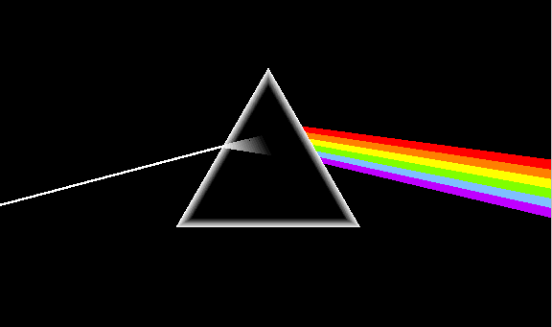
Pseudo-code for PRISM
For each class C
Initialize E to the instance set
While E contains instances in class C
Create a rule R with an empty left-hand side that predicts class C
Until R is perfect (or there are no more attributes to use) do
For each attribute A not mentioned in R, and each value v,
Consider adding the condition A = v to the left-hand side of R
Select A and v to maximize the accuracy p/t
(break ties by choosing the condition with the largest p)
Add A = v to R
Remove the instances covered by R from E

Slide 57
Rules vs. decision lists
PRISM with outer loop removed generates a decision list for one class
Subsequent rules are designed for instances that are not covered by previous rules
But: order does not matter because all rules predict the same class so outcome does not change if rules are shuffled
Outer loop considers all classes separately
No order dependence implied
Problems: overlapping rules, default rule required

Slide 58
Separate and conquer rule learning
Rule learning methods like the one PRISM employs (for each class) are called separate-and-conquer algorithms:
First, identify a useful rule
Then, separate out all the instances it covers
Finally, “conquer” the remaining instances
Difference to divide-and-conquer methods:
Subset covered by a rule does not need to be explored any further

Slide 59
Mining association rules
Naïve method for finding association rules:
Use separate-and-conquer method
Treat every possible combination of attribute values as a separate class
Two problems:
Computational complexity
Resulting number of rules (which would have to be pruned on the basis of support and confidence)
It turns out that we can look for association rules with high support and accuracy directly

Slide 60
Item sets: the basis for finding rules
Support: number of instances correctly covered by association rule
The same as the number of instances covered by all tests in the rule (LHS and RHS!)
Item: one test/attribute-value pair
Item set : all items occurring in a rule
Goal: find only rules that exceed pre-defined support
⇒ Do it by finding all item sets with the given minimum support and generating rules from them!

Slide 61
Weather data
Outlook
Temp
Humidity
Windy
Play
Sunny
Hot
High
False
No
Sunny
Hot
High
True
No
Overcast
Hot
High
False
Yes
Rainy
Mild
High
False
Yes
Rainy
Cool
Normal
False
Yes
Rainy
Cool
Normal
True
No
Overcast
Cool
Normal
True
Yes
Sunny
Mild
High
False
No
Sunny
Cool
Normal
False
Yes
Rainy
Mild
Normal
False
Yes
Sunny
Mild
Normal
True
Yes
Overcast
Mild
High
True
Yes
Overcast
Hot
Normal
False
Yes
Rainy
Mild
High
True
No

Slide 62
Item sets for weather data
One-item sets
Two-item sets
Three-item sets
Four-item sets
Outlook = Sunny (5)
Outlook = Sunny
Temperature = Hot (2)
Outlook = Sunny
Temperature = Hot
Humidity = High (2)
Outlook = Sunny
Temperature = Hot
Humidity = High
Play = No (2)
Temperature = Cool (4)
Outlook = Sunny
Humidity = High (3)
Outlook = Sunny
Humidity = High
Windy = False (2)
Outlook = Rainy
Temperature = Mild
Windy = False
Play = Yes (2)
…
…
…
…
Total number of item sets with a minimum support of at least two instances: 12 one-item sets, 47 two-item sets, 39 three-item sets, 6 four-item sets and 0 five-item sets

Slide 63
Generating rules from an item set
Once all item sets with the required minimum support have been generated, we can turn them into rules
Example 3-item set with a support of 4 instances:
Seven (2^{N}-1) potential rules:
Humidity = Normal, Windy = False, Play = Yes (4)
If Humidity = Normal and Windy = False then Play = Yes
If Humidity = Normal and Play = Yes then Windy = False
If Windy = False and Play = Yes then Humidity = Normal
If Humidity = Normal then Windy = False and Play = Yes
If Windy = False then Humidity = Normal and Play = Yes
If Play = Yes then Humidity = Normal and Windy = False
If True then Humidity = Normal and Windy = False and Play = Yes
4/4
4/6
4/6
4/7
4/8
4/9
4/14

Slide 64
Rules for weather data
All rules with support > 1 and confidence = 100%:
In total: 3 rules with support four 5 with support three 50 with support two
Association rule
Sup.
Conf.
1
Humidity=Normal Windy=False
⇒ Play=Yes
4
100%
2
Temperature=Cool
⇒ Humidity=Normal
4
100%
3
Outlook=Overcast
⇒ Play=Yes
4
100%
4
Temperature=Cold Play=Yes
⇒ Humidity=Normal
3
100%
...
...
...
...
58
Outlook=Sunny Temperature=Hot
⇒ Humidity=High
2
100%

Slide 65
Example rules from the same item set
Item set:
Resulting rules (all with 100% confidence):
We can establish their confidence due to the following “frequent” item sets:
Temperature = Cool, Humidity = Normal, Windy = False, Play = Yes (2)
Temperature = Cool, Windy = False ⇒ Humidity = Normal, Play = Yes
Temperature = Cool, Windy = False, Humidity = Normal ⇒ Play = Yes
Temperature = Cool, Windy = False, Play = Yes ⇒ Humidity = Normal
Temperature = Cool, Windy = False (2)
Temperature = Cool, Humidity = Normal, Windy = False (2)
Temperature = Cool, Windy = False, Play = Yes (2)

Slide 66
Generating item sets efficiently
How can we efficiently find all frequent item sets?
Finding one-item sets easy
Idea: use one-item sets to generate two-item sets, two-item sets to generate three-item sets, …
If (A B) is a frequent item set, then (A) and (B) have to be frequent item sets as well!
In general: if X is a frequent k-item set, then all (k-1)-item subsets of X are also frequent
⇒ Compute k-item sets by merging (k-1)-item sets

Slide 67
Example
Given: five frequent three-item sets
(A B C), (A B D), (A C D), (A C E), (B C D)
Lexicographically ordered!
Candidate four-item sets:
(A B C D) OK because of (A C D) (B C D)
(A C D E) Not OK because of (C D E)
To establish that these item sets are really frequent, we need to perform a final check by counting instances
For fast look-up, the (k –1)-item sets are stored in a hash table

Slide 68
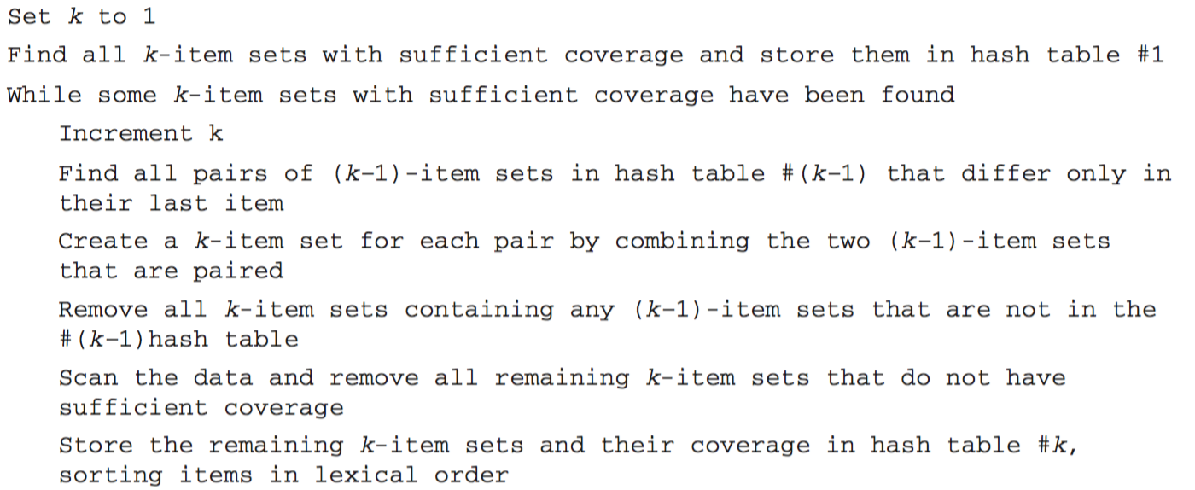
Algorithm for finding item sets

Slide 69
Generating rules efficiently
We are looking for all high-confidence rules
Support of antecedent can be obtained from item set hash table
But: brute-force method is (2^{N}-1) for an N-item set
Better way: building (c + 1)-consequent rules from c-consequent ones
Observation: (c + 1)-consequent rule can only hold if all corresponding c-consequent rules also hold
Resulting algorithm similar to procedure for large item sets

Slide 70
Example
1-consequent rules:
Corresponding 2-consequent rule:
Final check of antecedent against item set hash table is required to check that rule is actually sufficiently accurate
If Outlook = Sunny and Windy = False and Play = No then Humidity = High (2/2)
If Humidity = High and Windy = False and Play = No then Outlook = Sunny (2/2)
If Windy = False and Play = No then Outlook = Sunny and Humidity = High (2/2)

Slide 71
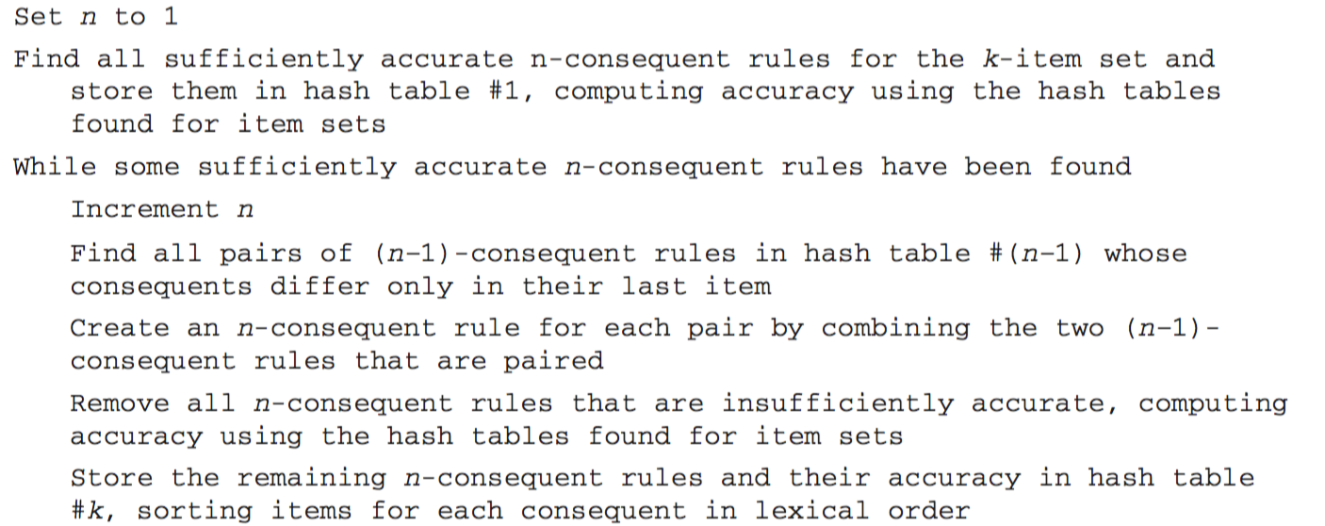
Algorithm for finding association rules

Slide 72
Association rules: discussion
Above method makes one pass through the data for each different item set size
Another possibility: generate (k+2)-item sets just after (k+1)-item sets have been generated
Result: more candidate (k+2)-item sets than necessary will be generated but this requires less passes through the data
Makes sense if data too large for main memory
Practical issue: support level for generating a certain minimum number of rules for a particular dataset
This can be done by running the whole algorithm multiple times with different minimum support levels
Support level is decreased until a sufficient number of rules has been found

Slide 73
Other issues
Standard ARFF format very inefficient for typical market basket data
Attributes represent items in a basket and most items are usually missing from any particular basket
Data should be represented in sparse format
Note on terminology: instances are also called transactions in the literature on association rule mining
Confidence is not necessarily the best measure
Example: milk occurs in almost every supermarket transaction
Other measures have been devised (e.g., lift)
It is often quite difficult to find interesting patterns in the large number of association rules that can be generated

Slide 74
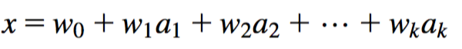
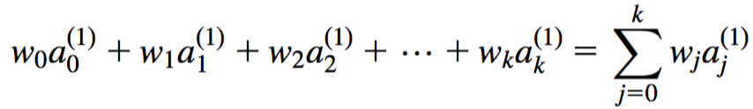
Linear models: linear regression
Work most naturally with numeric attributes
Standard technique for numeric prediction
Outcome is linear combination of attributes
Weights are calculated from the training data
Predicted value for first training instance a⁽¹⁾ (assuming each instance is extended with a constant attribute with value 1)

Slide 75
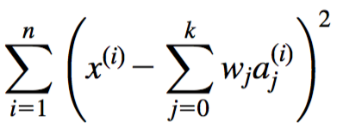
Minimizing the squared error
Choose k +1 coefficients to minimize the squared error on the training data
Squared error:
Coefficients can be derived using standard matrix operations
Can be done if there are more instances than attributes (roughly speaking)
Minimizing the absolute error is more difficult

Slide 76
Classification
Any regression technique can be used for classification
Training: perform a regression for each class, setting the output to 1 for training instances that belong to class, and 0 for those that don’t
Prediction: predict class corresponding to model with largest output value (membership value)
For linear regression this method is also known as multi-response linear regression
Problem: membership values are not in the [0,1] range, so they cannot be considered proper probability estimates
In practice, they are often simply clipped into the [0,1] range and normalized to sum to 1

Slide 77
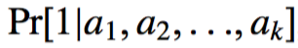
Linear models: logistic regression
Can we do better than using linear regression for classification?
Yes, we can, by applying logistic regression
Logistic regression builds a linear model for a transformed target variable
Assume we have two classes
Logistic regression replaces the target by this target
This logit transformation maps [0,1] to (-∞ , +∞ ), i.e., the new target values are no longer restricted to the [0,1] interval

Slide 78
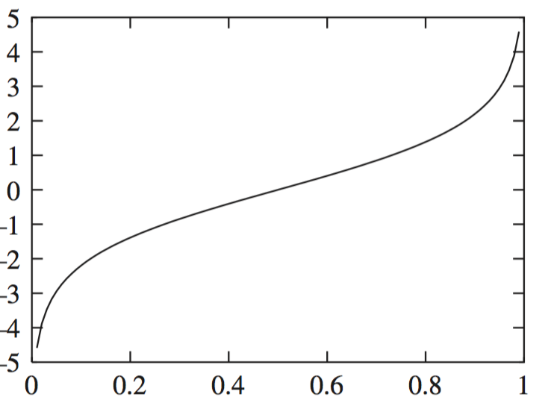
Logit transformation
Resulting class probability model:

Slide 79
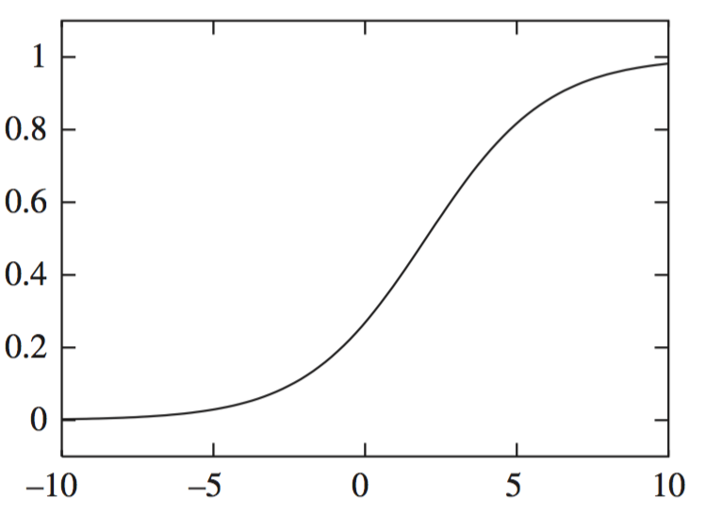
Example logistic regression model
Model with w₀ = -1.25 and w₁ = 0.5:
Parameters are found from training data using maximum likelihood

Slide 80
Maximum likelihood
Aim: maximize probability of observed training data with respect to final parameters of the logistic regression model
We can use logarithms of probabilities and maximize conditional log-likelihood instead of product of probabilities: where the class values x^{(i)} are either 0 or 1
Weights w_{i} need to be chosen to maximize log-likelihood
A relatively simple method to do this is iteratively re-weighted least squares but other optimization methods can be used

Slide 81
Multiple classes
Logistic regression for two classes is also called binomial logistic regression
What do we do when have a problem with k classes?
Can perform logistic regression independently for each class (like in multi-response linear regression)
Problem: the probability estimates for the different classes will generally not sum to one
Better: train k-1 coupled linear models by maximizing likelihood over all classes simultaneously
This is known as multi-class logistic regression, multinomial logistic regression or polytomous logistic regression
Alternative multi-class approach that often works well in practice: pairwise classification

Slide 82
Pairwise classification
Idea: build model for each pair of classes, using only training data from those classes
Classifications are derived by voting: given a test instance, let each model vote for one of its two classes
Problem? Have to train k(k-1)/2 two-class classification models for a k-class problem
Turns out not to be a problem in many cases because pairwise training sets become small:
Assume data evenly distributed, i.e., 2n/k instances per learning problem for n instances in total
Suppose training time of learning algorithm is linear in n
Then runtime for the training process is proportional to (k(k-1)/2)×(2n/k) = (k-1)n, i.e., linear in the number of classes and the number of instances
Even more beneficial if learning algorithm scales worse than linearly

Slide 83
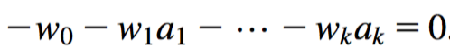
Linear models are hyperplanes
Decision boundary for two-class logistic regression is where probability equals 0.5: which occurs when
Thus logistic regression can only separate data that can be separated by a hyperplane
Multi-response linear regression has the same problem. Class 1 is assigned if:

Slide 84
Linear models: the perceptron
Observation: we do not actually need probability estimates if all we want to do is classification
Different approach: learn separating hyperplane directly
Let us assume the data is linearly separable
In that case there is a simple algorithm for learning a separating hyperplane called the perceptron learning rule
Hyperplane: where we again assume that there is a constant attribute with value 1 (bias)
If the weighted sum is greater than zero we predict the first class, otherwise the second class

Slide 85
The algorithm
Set all weights to zero
Until all instances in the training data are classified correctly
For each instance I in the training data
If I is classified incorrectly by the perceptron
If I belongs to the first class add it to the weight vector
else subtract it from the weight vector
Why does this work? Consider a situation where an instance a pertaining to the first class has been added: This means the output for a has increased by: This number is always positive, thus the hyperplane has moved into the correct direction (and we can show that output decreases for instances of other class)
It can be shown that this process converges to a linear separator if the data is linearly separable

Slide 86
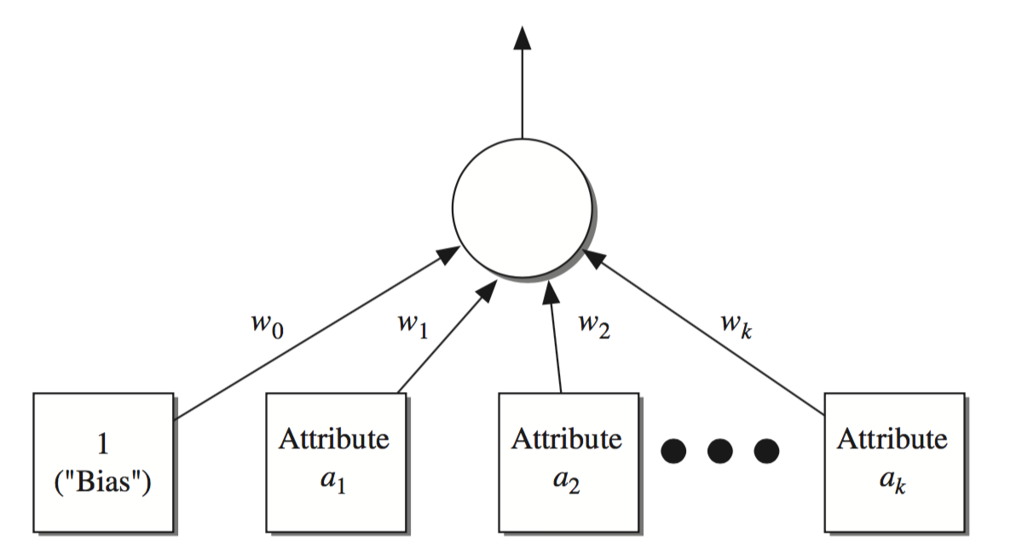
Perceptron as a neural network
Output
layer
Input
layer

Slide 87
Linear models: Winnow
The perceptron is driven by mistakes because the classifier only changes when a mistake is made
Another mistake-driven algorithm for finding a separating hyperplane is known as Winnow
Assumes binary data (i.e., attribute values are either zero or one)
Difference to perceptron learning rule: multiplicative updates instead of additive updates
Weights are multiplied by a user-specified parameter α > 1 (or its inverse)
Another difference: user-specified threshold parameter θ
Predict first class if

Slide 88
The algorithm
while some instances are misclassified
for each instance a in the training data
classify a using the current weights
if the predicted class is incorrect
if a belongs to the first class
for each a_{i} that is 1, multiply w_{i} by alpha
(if a_{i} is 0, leave w_{i} unchanged)
otherwise
for each a_{i} that is 1, divide w_{i} by alpha
(if a_{i} is 0, leave w_{i} unchanged)
Winnow is very effective in homing in on relevant features (it is attribute efficient)
Can also be used in an on-line setting in which new instances arrive continuously (like the perceptron algorithm)

Slide 89
Balanced Winnow
Winnow does not allow negative weights and this can be a drawback in some applications
Balanced Winnow maintains two weight vectors, one for each class:
Instance is classified as belonging to the first class if:
while some instances are misclassified
for each instance a in the training data
classify a using the current weights
if the predicted class is incorrect
if a belongs to the first class
for each a_{i} that is 1, multiply w_{i}⁺ by alpha and divide w_{i}⁻ by alpha
(if a_{i} is 0, leave w_{i}⁺ and w_{i}⁻ unchanged)
otherwise
for each a_{i} that is 1, multiply w_{i}⁻ by alpha and divide w_{i}⁺ by alpha
(if a_{i} is 0, leave w_{i}⁺ and w_{i}⁻ unchanged)

Slide 90
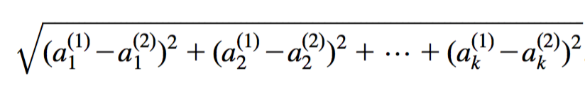
Instance-based learning
In instance-based learning the distance function defines what is learned
Most instance-based schemes use Euclidean distance: a⁽¹⁾ and a⁽²⁾: two instances with k attributes
Note that taking the square root is not required when comparing distances
Other popular metric: city-block metric
Adds differences without squaring them

Slide 91
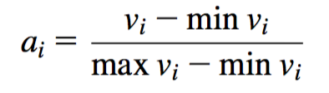
Normalization and other issues
Different attributes are measured on different scales ⇒ need to be normalized, e.g., to range [0,1]:
v_{i} : the actual value of attribute i
Nominal attributes: distance is assumed to be either 0 (values are the same) or 1 (values are different)
Common policy for missing values: assumed to be maximally distant (given normalized attributes)

Slide 92
Finding nearest neighbors efficiently
Simplest way of finding nearest neighbour: linear scan of the data
Classification takes time proportional to the product of the number of instances in training and test sets
Nearest-neighbor search can be done more efficiently using appropriate data structures
We will discuss two methods that represent training data in a tree structure: kD-trees and ball trees

Slide 93
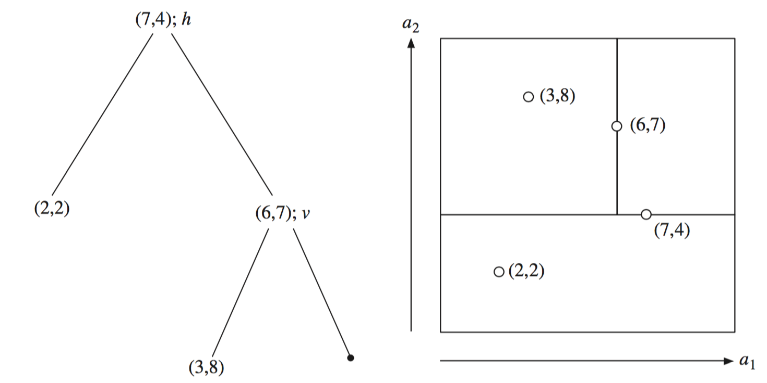
kD-tree example

Slide 94
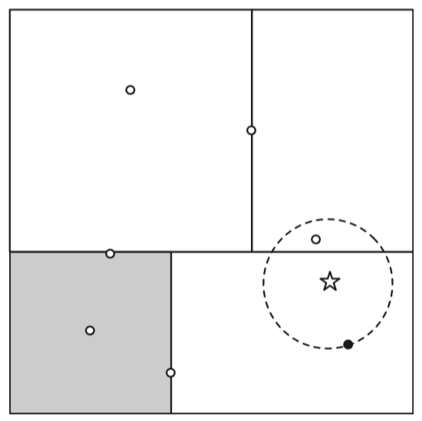
Using kD-trees: example
query ball

Slide 95
More on kD-trees
Complexity depends on depth of the tree, given by the logarithm of number of nodes for a balanced tree
Amount of backtracking required depends on quality of tree (“square” vs. “skinny” nodes)
How to build a good tree? Need to find good split point and split direction
Possible split direction: direction with greatest variance
Possible split point: median value along that direction
Using value closest to mean (rather than median) can be better if data is skewed
Can apply this split selection strategy recursively just like in the case of decision tree learning

Slide 96
Building trees incrementally
Big advantage of instance-based learning: classifier can be updated incrementally
Just add new training instance!
Can we do the same with kD-trees?
Heuristic strategy:
Find leaf node containing new instance
Place instance into leaf if leaf is empty
Otherwise, split leaf according to the longest dimension (to preserve squareness)
Tree should be re-built occasionally (e.g., if depth grows to twice the optimum depth for given number of instances)

Slide 97
Ball trees
Potential problem in kD-trees: corners in high-dimensional space may mean query ball intersects with many regions
Observation: no need to make sure that regions do not overlap, so they do not need to be hyperrectangles
Can use balls (hyperspheres) instead of hyperrectangles
A ball tree organizes the data into a tree of k-dimensional hyperspheres
Motivation: balls may allow for a better fit to the data and thus more efficient search

Slide 98
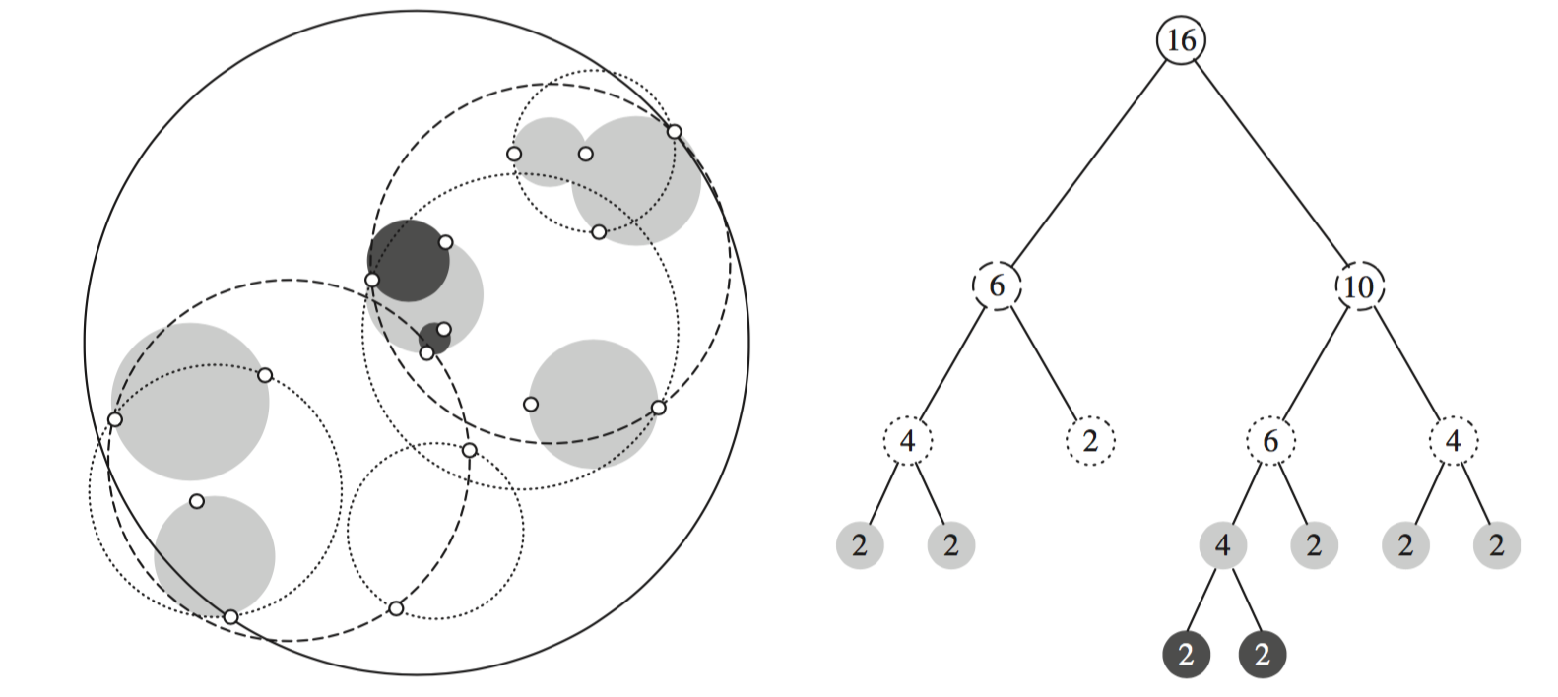
Ball tree example

Slide 99
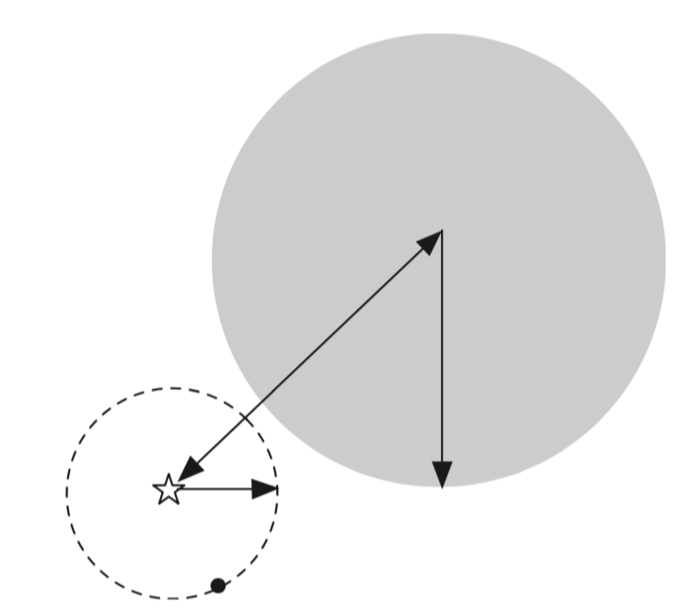
Using ball trees
Nearest-neighbor search is done using the same backtracking strategy as in kD-trees
Ball can be ruled out during search if distance from target to ball's center exceeds ball's radius plus radius of query ball

Slide 100
Building ball trees
Ball trees are built top down, applying the same recursive strategy as in kD-trees
We do not have to continue until leaf balls contain just two points: can enforce minimum occupancy (this can also be done for efficiency in kD-trees)
Basic problem: splitting a ball into two
Simple (linear-time) split selection strategy:
Choose point farthest from ball's center
Choose second point farthest from first one
Assign each point to these two points
Compute cluster centers and radii based on the two subsets to get two successor balls

Slide 101
Discussion of nearest-neighbor learning
Often very accurate
Assumes all attributes are equally important
Remedy: attribute selection, attribute weights, or attribute scaling
Possible remedies against noisy instances:
Take a majority vote over the k nearest neighbors
Remove noisy instances from dataset (difficult!)
Statisticians have used k-NN since the early 1950s
If n → ∞ and k/n → 0, classification error approaches minimum
kD-trees can become inefficient when the number of attributes is too large
Ball trees are instances may help; they are instances of metric trees

Slide 102
Clustering
Clustering techniques apply when there is no class to be predicted: they perform unsupervised learning
Aim: divide instances into “natural” groups
As we have seen, clusters can be:
disjoint vs. overlapping
deterministic vs. probabilistic
flat vs. hierarchical
We will look at a classic clustering algorithm called k-means
k-means clusters are disjoint, deterministic, and flat

Slide 103
The k-means algorithm
Step 1: Choose k random cluster centers
Step 2: Assign each instance to its closest cluster center based on Euclidean distance
Step 3: Recompute cluster centers by computing the average (aka centroid) of the instances pertaining to each cluster
Step 4: If cluster centers have moved, go back to Step 2
This algorithm minimizes the squared Euclidean distance of the instances from their corresponding cluster centers
Determines a solution that achieves a local minimum of the squared Euclidean distance
Equivalent termination criterion: stop when assignment of instances to cluster centers has not changed

Slide 104
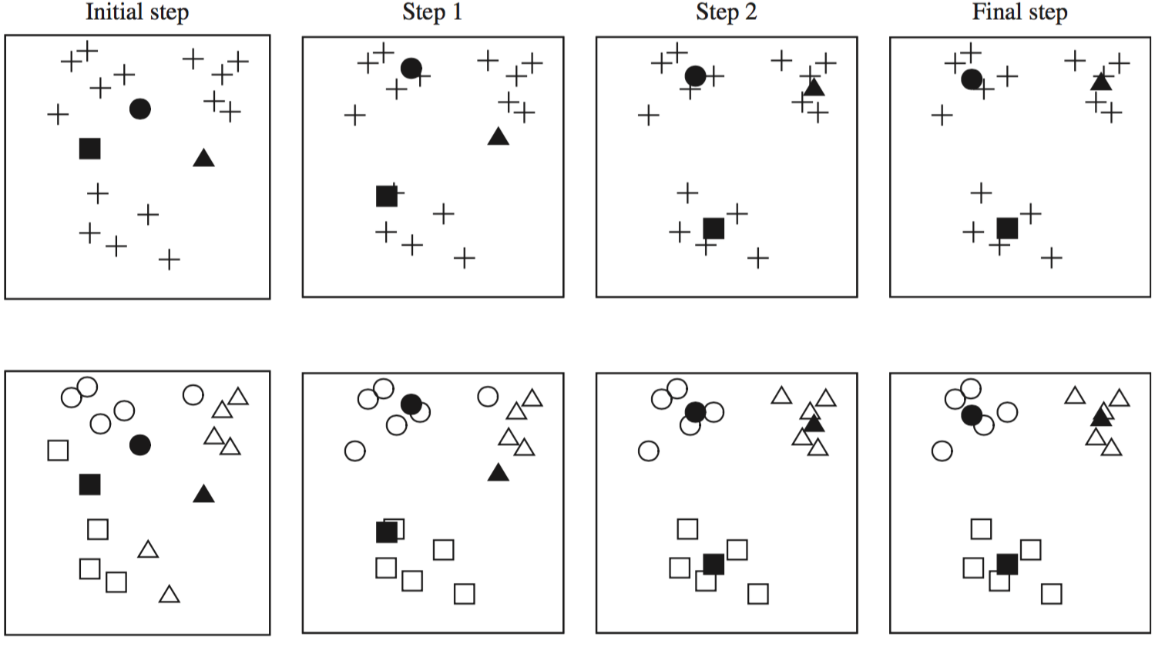
The k-means algorithm: example

Slide 105
Discussion
Algorithm minimizes squared distance to cluster centers
Result can vary significantly
based on initial choice of seeds
Can get trapped in local minimum
Example:
To increase chance of finding global optimum: restart with different random seeds
Can we applied recursively with k = 2
initial cluster centres
instances

Slide 106
Faster distance calculations
Can we use kD-trees or ball trees to speed up the process? Yes, we can:
First, build the tree data structure, which remains static, for all the data points
At each node, store the number of instances and the sum of all instances (summary statistics)
In each iteration of k-means, descend the tree and find out which cluster each node belongs to
Can stop descending as soon as we find out that a node belongs entirely to a particular cluster
Use summary statistics stored previously at the nodes to compute new cluster centers

Slide 107
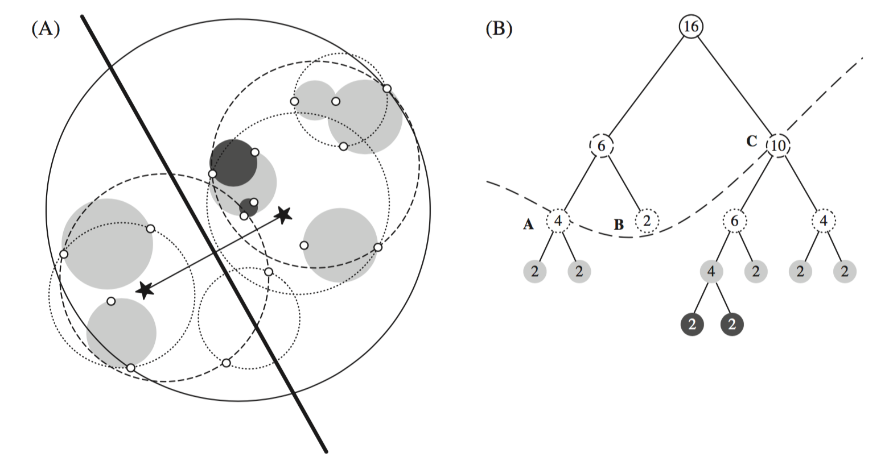
Example scenario (using a ball tree)

Slide 108
Choosing the number of clusters
Big question in practice: what is the right number of clusters, i.e., what is the right value for k?
Cannot simply optimize squared distance on training data to choose k
Squared distance decreases monotonically with increasing values of k
Need some measure that balances distance with complexity of the model, e.g., based on the MDL principle (covered later)
Finding the right-size model using MDL becomes easier when applying a recursive version of k-means (bisecting k-means):
Compute A: information required to store data centroid, and the location of each instance with respect to this centroid
Split data into two clusters using 2-means
Compute B: information required to store the two new cluster centroids, and the location of each instance with respect to these two
If A > B, split the data and recurse (just like in other tree learners)

Slide 109
Hierarchical clustering
Bisecting k-means performs hierarchical clustering in a top-down manner
Standard hierarchical clustering performs clustering in a bottom-up manner; it performs agglomerative clustering:
First, make each instance in the dataset into a trivial mini-cluster
Then, find the two closest clusters and merge them; repeat
Clustering stops when all clusters have been merged into a single cluster
Outcome is determined by the distance function that is used:
Single-linkage clustering: distance of two clusters is measured by finding the two closest instances, one from each cluster, and taking their distance
Complete-linkage clustering: use the two most distant instances instead
Average-linkage clustering: take average distance between all instances
Centroid-linkage clustering: take distance of cluster centroids
Group-average clustering: take average distance in merged clusters
Ward’s method: optimize k-means criterion (i.e., squared distance)

Slide 110
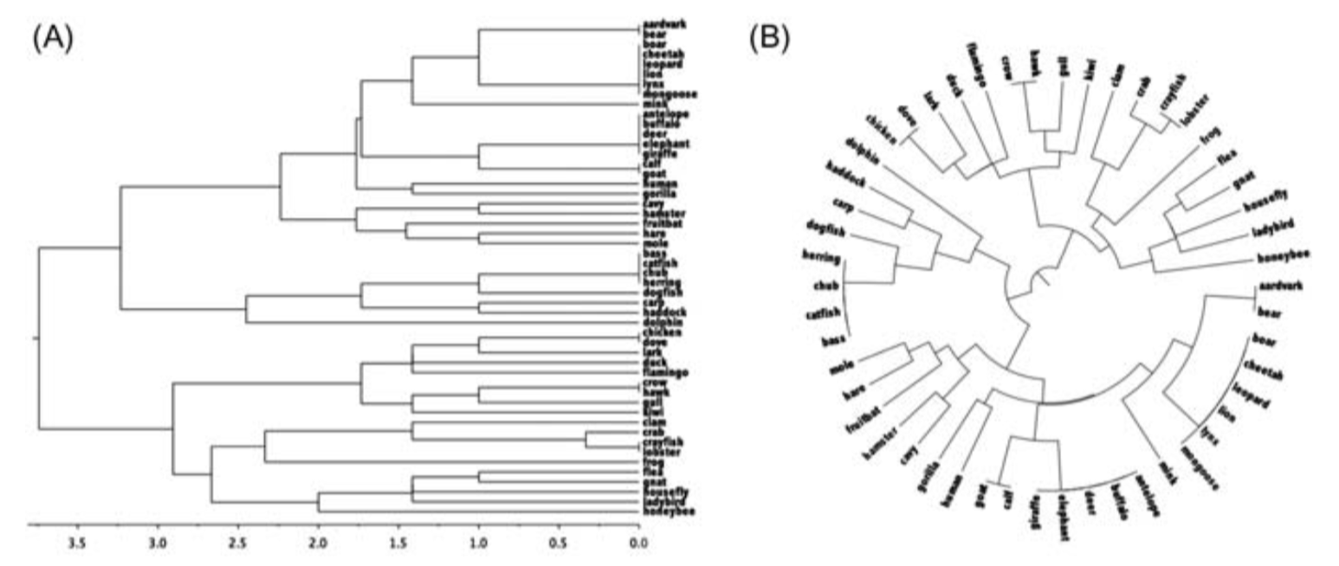
Example: complete linkage

Slide 111
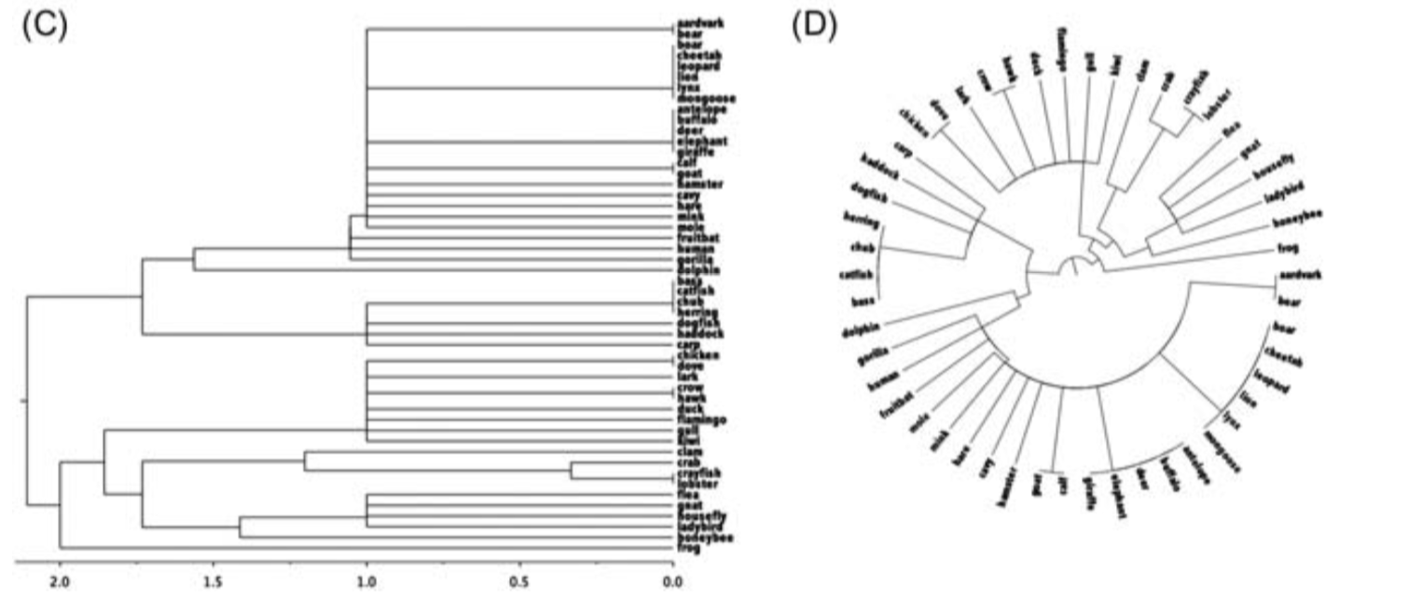
Example: single linkage

Slide 112
Incremental clustering
Heuristic approach (COBWEB/CLASSIT)
Forms a hierarchy of clusters incrementally
Start:
tree consists of empty root node
Then:
add instances one by one
update tree appropriately at each stage
to update, find the right leaf for an instance
may involve restructuring the tree using merging or splitting of nodes
Update decisions are based on a goodness measure called category utility

Slide 113
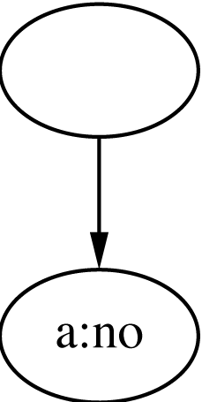
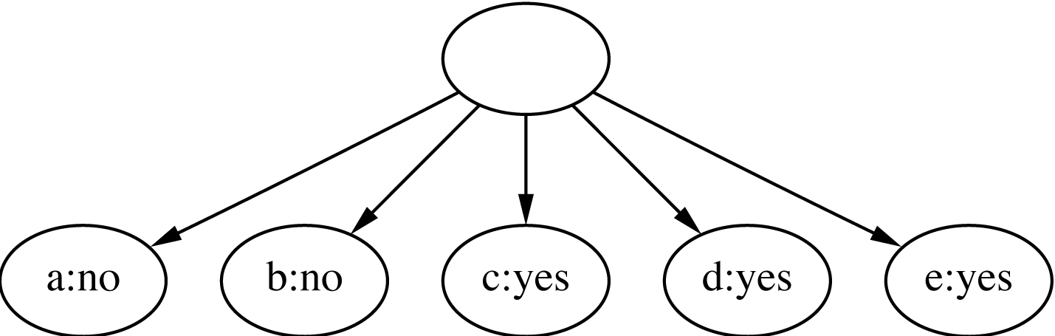
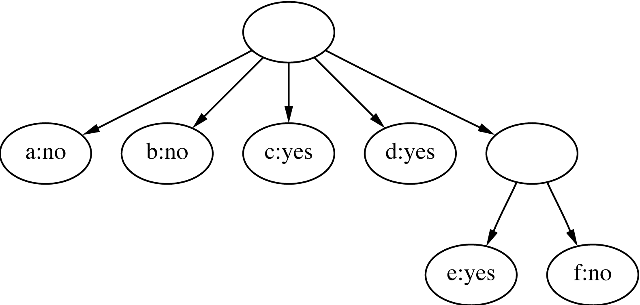
Clustering the weather data I
1
ID | Outlook | Temp. | Humidity | Windy
A | Sunny | Hot | High | False
B | Sunny | Hot | High | True
C | Overcast | Hot | High | False
D | Rainy | Mild | High | False
E | Rainy | Cool | Normal | False
F | Rainy | Cool | Normal | True
G | Overcast | Cool | Normal | True
H | Sunny | Mild | High | False
I | Sunny | Cool | Normal | False
J | Rainy | Mild | Normal | False
K | Sunny | Mild | Normal | True
L | Overcast | Mild | High | True
M | Overcast | Hot | Normal | False
N | Rainy | Mild | High | True
2
3

Slide 114
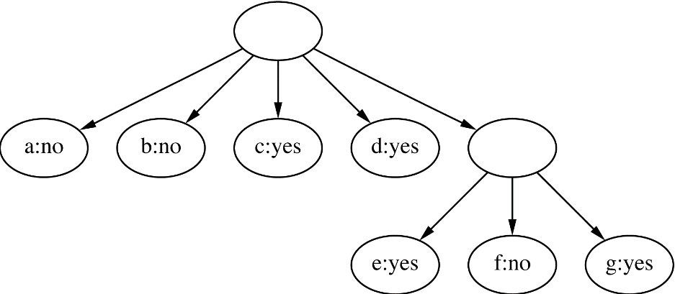
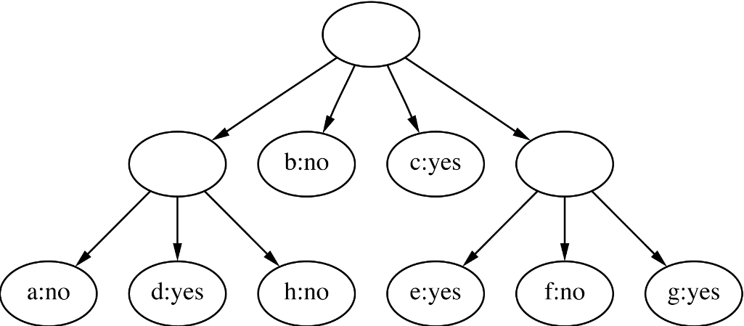
Clustering the weather data II
4
ID | Outlook | Temp. | Humidity | Windy
A | Sunny | Hot | High | False
B | Sunny | Hot | High | True
C | Overcast | Hot | High | False
D | Rainy | Mild | High | False
E | Rainy | Cool | Normal | False
F | Rainy | Cool | Normal | True
G | Overcast | Cool | Normal | True
H | Sunny | Mild | High | False
I | Sunny | Cool | Normal | False
J | Rainy | Mild | Normal | False
K | Sunny | Mild | Normal | True
L | Overcast | Mild | High | True
M | Overcast | Hot | Normal | False
N | Rainy | Mild | High | True
5
Merge best host and runner-up
3
Consider splitting the best host if merging does not help

Slide 115

Final clustering

Slide 116

Example: clustering a subset of the iris data

Slide 117

Example: iris data with cutoff

Slide 118
The category utility measure
Category utility: quadratic loss function defined on conditional probabilities:
Every instance in a different category ⇒ numerator becomes
maximum
number of attributes

Slide 119
Numeric attributes?
Assume normal distribution:
Then:
Thus becomes
Prespecified minimum variance can be enforced to combat overfitting (called acuity parameter)

Slide 120
Multi-instance learning
Recap: multi-instance learning is concerned with examples corresponding to sets (really, bags or multi-sets) of instances
All instances have the same attributes but the full set of instances is split into subsets of related instances that are not necessarily independent
These subsets are the examples for learning
Example applications of multi-instance learning: image classification, classification of molecules
Simplicity-first methodology can be applied to multi-instance learning with surprisingly good results
Two simple approaches to multi-instance learning, both using standard single-instance learners:
Manipulate the input to learning
Manipulate the output of learning

Slide 121
Aggregating the input
Idea: convert multi-instance learning problem into a single-instance one
Summarize the instances in a bag by computing the mean, mode, minimum and maximum, etc., of each attribute as new attributes
“Summary” instance retains the class label of its bag
To classify a new bag the same process is used
Any single-instance learning method, e.g., decision tree learning, can be applied to the resulting data
This approach discards most of the information in a bag of instances but works surprisingly well in practice
Should be used as a base line when evaluating more advanced approaches to multi-instance learning
More sophisticated region-based summary statistics can be applied to extend this basic approach

Slide 122
Aggregating the output
Idea: learn a single-instance classifier directly from the original instances in all the bags
Each instance is given the class of the bag it originates from
But: bags can contain differing numbers of instances → give each instance a weight inversely proportional to the bag's size
To classify a new bag:
Produce a prediction for each instance in the bag
Aggregate the predictions to produce a prediction for the bag as a whole
One approach: treat predictions as votes for the various class labels; alternatively, average the class probability estimates
This approach treats all instances as independent at training time, which is not the case in true multi-instance applications
Nevertheless, it often works very well in practice and should be used as a base line

Slide 123
Some final comments on the basic methods
Bayes’ rule stems from his “Essay towards solving a problem in the doctrine of chances” (1763)
Difficult bit in general: estimating prior probabilities (easy in the case of naïve Bayes)
Extension of naïve Bayes: Bayesian networks (which we will discuss later)
The algorithm for association rules we discussed is called APRIORI; many other algorithms exist
Minsky and Papert (1969) showed that linear classifiers have limitations, e.g., can’t learn a logical XOR of two attributes
But: combinations of them can (this yields multi-layer neural nets, which we will discuss later)

